Slide 1
Mini-project I
Wonho Choi

Slide 2


Tools Used
Jupyter Notebook
import requests
import json
from IPython.display import JSON
import datetime as datetime
from pytz import timezone

Slide 3
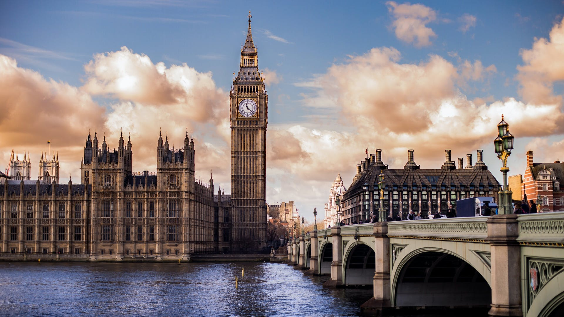
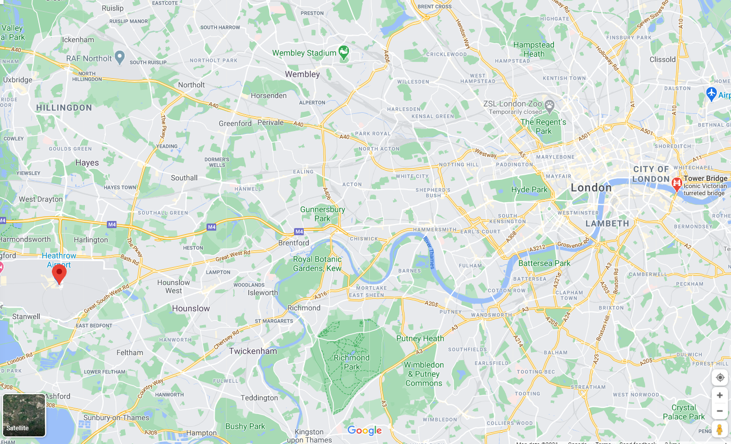
Location: London, United Kingdom
Heathrow Airport: 51.480764°N, 0.456982°W
Tower Bridge: 51.502500°N, 0.077270°W

Slide 4

How many requests do you need to send while getting enough results for the
large data collection?
Tip
In order to minimize the use of requests and maximize the amount of interactions with data, I made our modern RAM to do most of the jobs!
And also it improves the speed!
JS=requests.get('https://api.tfl.gov.uk/Place/Type/'+types).json().copy()

Slide 5
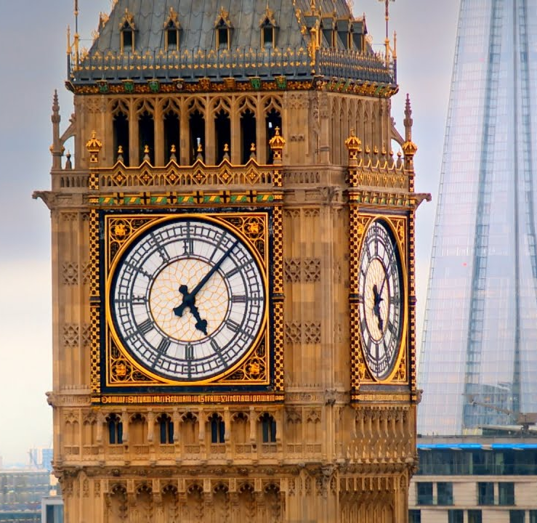
London’s local Time matters
London_time= datetime.datetime.now(timezone("Europe/London")).isoformat()
import datetime as datetime
from pytz import timezone

Slide 6
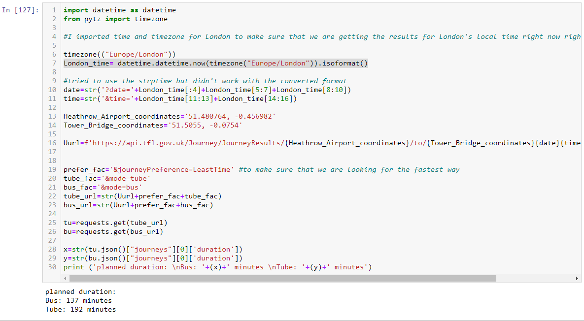
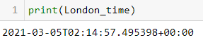
So bus was faster.
At this time:

Slide 7
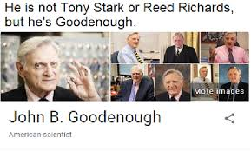

However,

Slide 8
New Plan: Best Route with All Detail
Use All Mixed Modes When Necessary For the best efficiency
All Details Displayed
Just like google maps!

Slide 9
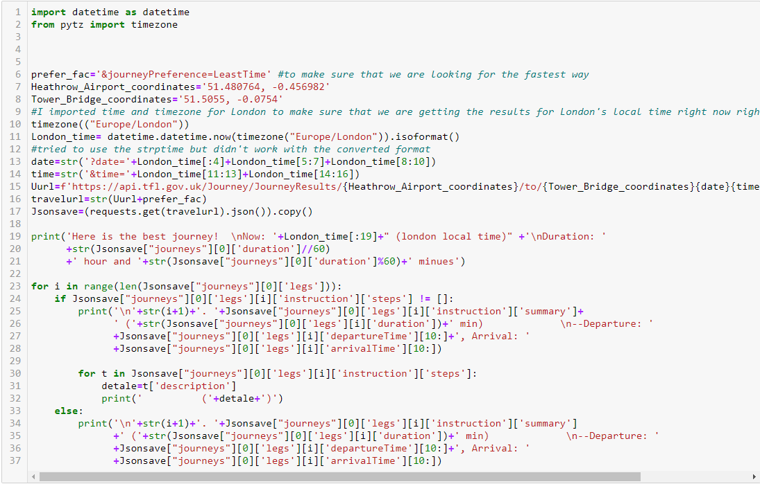
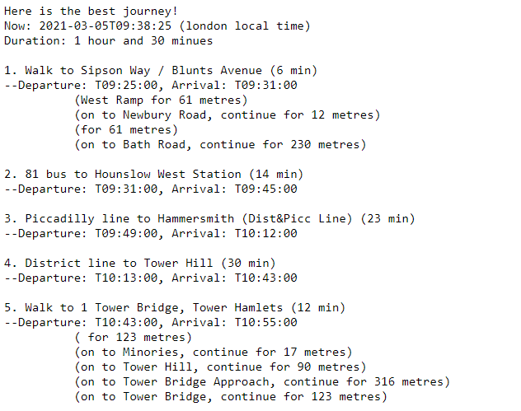
After A Long Coding:

Slide 10
However,
(Still)

Slide 11
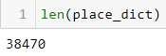
{'Farringdon/Smithfield': '51.521764, -0.106371',
'Haringey Heartlands/Wood Green': '51.592511, -0.115218',
'Holborn': '51.520279, -0.119356',
'Kidbrooke': '51.460266, 0.026341',
'Mill Hill East': '51.610741, -0.209173',
'South Wimbledon/Colliers Wood': '51.425652, -0.184096',
'West Hampstead Interchange': '51.547555, -0.189698',
'Leman Street, Aldgate': '51.512363, -0.069542',
'West Smithfield Rotunda, Farringdon': '51.518218, -0.100791',
'Margery Street, Clerkenwell': '51.526599, -0.112432',
'New Road 1 , Whitechapel': '51.518154, -0.062697',
'Grosvenor Crescent, Belgravia': '51.501352, -0.153194',
'Mallory Street, Marylebone': '51.525051, -0.166304',
'Denyer Street, Knightsbridge': '51.493583, -0.165101',
'Hinde Street, Marylebone': '51.516814, -0.151926',
'Cadogan Place, Knightsbridge': '51.494645, -0.158105',
'Campden Hill Road, Notting Hill': '51.506584, -0.199004',
'Wellington Arch, Hyde Park': '51.50274, -0.149569',
'Endsleigh Gardens, Euston': '51.526838, -0.130504',
'Moorfields, Moorgate': '51.519069, -0.088285',
'Old Brompton Road, South Kensington': '51.490945, -0.18119',
'Wormwood Street, Liverpool Street': '51.516154, -0.082422',
"St. Luke's Church, Chelsea": '51.489716, -0.170194',
"Bramham Gardens, Earl's Court": '51.490163, -0.190393',
'Chelsea Green, Chelsea': '51.490664, -0.166485',
'Horseferry Road, Westminster': '51.494816, -0.130458',
'Knightsbridge, Hyde Park': '51.502757, -0.155349',
'Rodney Road , Walworth': '51.491484, -0.09022',
'Queensway, Kensington Gardens': '51.51031, -0.187402',
'Notting Hill Gate Station, Notting Hill': '51.509353, -0.196422',
'Charles II Street, West End': '51.508446, -0.131961',
'Great Percy Street, Clerkenwell': '51.528915, -0.11548',
"St. James's Square, St. James's": '51.507424, -0.134621',
'Whitehall Place, Strand': '51.506543, -0.123179',
'Poured Lines, Bankside': '51.506692, -0.103137',
"Queen's Gate (Central), South Kensington": '51.493967, -0.178732',
'Carey Street, Holborn': '51.51501, -0.112753',
'Pall Mall East, West End': '51.50777, -0.130699',
'Liverpool Road (N1 Centre), Angel': '51.534504, -0.106992',
'Kennington Road , Vauxhall': '51.495718, -0.110889',
'Fashion Street, Whitechapel': '51.51838, -0.073438',
'Dock Street, Wapping': '51.509786, -0.068161',
'Frampton Street, Paddington': '51.523353, -0.175116',
'Warren Street Station, Euston': '51.524438, -0.138019',
'Colombo Street, Southwark': '51.505459, -0.105692',
'Beaumont Street, Marylebone': '51.522008, -0.151359',
'Gloucester Street, Pimlico': '51.490962, -0.139625',
'Earnshaw Street , Covent Garden': '51.516118, -0.128585',
'Grosvenor Road, Pimlico': '51.485357, -0.142207',
'Berry Street, Clerkenwell': '51.522853, -0.099994',
"St. John's Wood Church, The Regent's Park": '51.530529, -0.167515',
'Triangle Car Park, Hyde Park': '51.506451, -0.170279',
'Harper Road, The Borough': '51.498597, -0.096191',
'Royal Avenue 1, Chelsea': '51.489932, -0.162727',
'Brushfield Street, Liverpool Street': '51.518908, -0.079249',
'Jubilee Gardens, South Bank': '51.504636, -0.116542',
'Shoreditch Park, Hoxton': '51.534042, -0.086379',
'Chadwell Street, Angel': '51.530515, -0.106408',
'Clifton Road, Maida Vale': '51.525575, -0.179592',
'Houghton Street, Strand': '51.51362, -0.116764',
'Westminster University, Marylebone': '51.522481, -0.154907',
'Kensington Gore, Knightsbridge': '51.501432, -0.178656',
'Bourne Street, Belgravia': '51.490959, -0.153233',
'Broadwick Street, Soho': '51.513684, -0.13558',
'Princes Square, Bayswater': '51.513489, -0.191351',
'LSBU (Borough Road), Elephant & Castle': '51.498744, -0.103132',
'St. Mary Axe, Aldgate': '51.514225, -0.08066',
'Tysoe Street, Clerkenwell': '51.526443, -0.109256',
'Southwick Street, Paddington': '51.515953, -0.169249',
"Queen's Gate (North), Kensington": '51.501026, -0.180246',
'Regency Street, Westminster': '51.49206, -0.132224',
'Belgrave Road, Victoria': '51.493204, -0.144132',
'Empire Square, The Borough': '51.500823, -0.08974',
'Kennington Lane Rail Bridge, Vauxhall': '51.486343, -0.122492',
"London Zoo, The Regent's Park": '51.535836, -0.156285',
'Baylis Road, Waterloo': '51.501444, -0.110699',
'Belvedere Road 1, South Bank': '51.506133, -0.114686',
'Warwick Road, Olympia': '51.496712, -0.205284',
'Barbican Centre, Barbican': '51.520044, -0.092176',
'Lower Thames Street, Monument': '51.509301, -0.084985',
'Tooley Street, Bermondsey': '51.503493, -0.07962',
'North Wharf Road, Paddington': '51.518622, -0.176645',
'Royal Avenue 2, Chelsea': '51.490083, -0.162418',
'Smith Square, Westminster': '51.495805, -0.127575',
'Royal London Hospital, Whitechapel': '51.518675, -0.06111',
'Kingsway, Covent Garden': '51.514409, -0.118478',
'Lambeth North Station, Waterloo': '51.49914, -0.112031',
"St. John's Wood Road, St. John's Wood": '51.527294, -0.174653',
'Bedford Way, Bloomsbury': '51.523673, -0.128377',
'Elizabeth Bridge, Victoria': '51.492369, -0.147478',
'South Audley Street, Mayfair': '51.50923, -0.151296',
"St Mary's Hospital, Paddington": '51.518268, -0.171103',
'Claverton Street, Pimlico': '51.484839, -0.138089',
'Montpelier Street, Knightsbridge': '51.498884, -0.165471',
'Kensington Olympia Station, Olympia': '51.498157, -0.209494',
"St. George's Square, Pimlico": '51.488226, -0.135635',
'Swan Street, The Borough': '51.500296, -0.092762',
"Knaresborough Place, Earl's Court": '51.493631, -0.190603',
'Geraldine Street, Elephant & Castle': '51.496127, -0.106',
'Curlew Street, Shad Thames': '51.502279, -0.074189',
'Vincent Square, Westminster': '51.493985, -0.136928',
'Serpentine Car Park, Hyde Park': '51.505014, -0.17306',
'Marylebone Lane, Marylebone': '51.514759, -0.148105',
'Elysium Place, Fulham': '51.471079, -0.207842',
'Eel Brook Common, Walham Green': '51.476259, -0.193254',
'Irene Road, Parsons Green': '51.473763, -0.19701',
'Surrey Lane, Battersea': '51.47518, -0.16716',
'Wandsworth Town Station, Wandsworth': '51.460864, -0.187427',
'Lansdowne Road, Ladbroke Grove': '51.507481, -0.205535',
'Nantes Close, Wandsworth': '51.46193, -0.180791',
'Courland Grove, Wandsworth Road': '51.472918, -0.132102',
"Queen's Circus, Battersea Park": '51.477619, -0.149551',
'Normand Park, West Kensington': '51.484386, -0.204815',
'Holden Street, Battersea': '51.46879, -0.15823',
'William Morris Way, Sands End': '51.468819, -0.184318',
'Morie Street, Wandsworth': '51.459953, -0.190184',
'Clarence Walk, Stockwell': '51.470732, -0.126994',
'Battersea Park Road, Nine Elms': '51.479501, -0.14177',
'Sheepcote Lane, Battersea': '51.470538, -0.163041',
'Vereker Road, West Kensington': '51.489591, -0.209378',
'Brook Green South, Brook Green': '51.494347, -0.215804',
'Greyhound Road, Hammersmith': '51.486062, -0.214428',
'South Park, Sands End': '51.467064, -0.193502',
'Falcon Road, Clapham Junction': '51.466633, -0.169821',
'Coomer Place, West Kensington': '51.48357, -0.202038',
'Silverthorne Road, Battersea': '51.472865, -0.148059',
"Archbishop's Park, Waterloo": '51.498241, -0.117495',
'Fawcett Close, Battersea': '51.469161, -0.174485',
"All Saints' Road, Portobello": '51.519042, -0.204764',
'Rainville Road, Hammersmith': '51.483732, -0.223852',
'Great Suffolk Street, The Borough': '51.501732, -0.100292',
'Buckingham Gate, Westminster': '51.498865, -0.137424',
"Richmond Way, Shepherd's Bush": '51.500353, -0.217515',
'Peterborough Road, Sands End': '51.46904, -0.196274',
"World's End Place, West Chelsea": '51.481805, -0.180274',
"St. Mark's Road, North Kensington": '51.51687, -0.213872',
'Thorndike Close, West Chelsea': '51.480898, -0.183853',
'Evesham Street, Avondale': '51.511486, -0.21819',
'Simpson Street, Clapham Junction': '51.470847, -0.170703',
'Ashmole Estate, Oval': '51.482678, -0.117661',
'Crabtree Lane, Fulham': '51.482944, -0.219346',
'Broomhouse Lane, Parsons Green': '51.468418, -0.199135',
"Blythe Road West, Shepherd's Bush": '51.49968, -0.221791',
'Ethelburga Estate, Battersea Park': '51.477292, -0.164786',
"Blackfriars Station, St. Paul's": '51.511934, -0.103078',
'West Kensington Station, West Kensington': '51.49087, -0.206029',
'All Saints Church, Portobello': '51.51632, -0.202608',
'Phene Street, Chelsea': '51.484984, -0.167919',
'Clarendon Road, Avondale': '51.51323, -0.211593',
'Austin Road, Battersea Park': '51.474376, -0.155442',
'Smugglers Way, Wandsworth': '51.461083, -0.191722',
"Shepherd's Bush Road North, Shepherd's Bush": '51.501594, -0.222293',
'Ravenscourt Park Station, Hammersmith': '51.494223, -0.236769',
'Teversham Lane, Stockwell': '51.476149, -0.123258',
'Ashley Crescent, Battersea': '51.467185, -0.152248',
'Parsons Green Station, Parsons Green': '51.475089, -0.201968',
'Hibbert Street, Battersea': '51.46517, -0.180389',
"Carnegie Street, King's Cross": '51.535467, -0.116191',
'Usk Road, Clapham Junction': '51.463489, -0.182126',
'Hartington Road, Stockwell': '51.47787, -0.126874',
'Heath Road, Battersea': '51.468669, -0.146544',
'Esmond Street, Putney': '51.462312, -0.211468',
'Orbel Street, Battersea': '51.474535, -0.17021',
'Westbridge Road, Battersea': '51.477684, -0.170329',
"Bishop's Avenue, Fulham": '51.473036, -0.214749',
'Crisp Road, Hammersmith': '51.488108, -0.226606',
'Dorothy Road, Clapham Junction': '51.465064, -0.16375',
'Neville Gill Close, Wandsworth': '51.454752, -0.195197',
'Osiers Road, Wandsworth': '51.46067, -0.198735',
'Beryl Road, Hammersmith': '51.488144, -0.222456',
'Maclise Road, Olympia': '51.497608, -0.211455',
'Northfields, Wandsworth': '51.460951, -0.200667',
'Spanish Road, Clapham Junction': '51.459225, -0.180884',
'Stanley Grove, Battersea': '51.470475, -0.15213',
'Erin Close, Walham Green': '51.479463, -0.195777',
'Cadogan Close, Victoria Park': '51.542118, -0.028941',
'Felsham Road, Putney': '51.464786, -0.215618',
'Putney Rail Station, Putney': '51.460717, -0.216526',
'Islington Green, Angel': '51.536384, -0.102757',
'Charing Cross Hospital, Hammersmith': '51.487285, -0.217995',
'Charlotte Terrace, Angel': '51.536392, -0.112721',
'Shoreditch Court, Haggerston': '51.539083, -0.070329',
'Belford House, Haggerston': '51.536654, -0.07023',
'Battersea Church Road, Battersea': '51.476964, -0.174347',
'Vicarage Crescent, Battersea': '51.472876, -0.176267',
'Durant Street, Bethnal Green': '51.528681, -0.06555',
'St. Bride Street, Holborn': '51.515059, -0.105344',
'Mexfield Road, East Putney': '51.45682, -0.202802',
'Upper Richmond Road, Putney': '51.459715, -0.212145',
'Snowsfields, London Bridge': '51.502153, -0.083632',
'Barons Court Station, West Kensington': '51.490217, -0.215087',
'Disraeli Road, Putney': '51.46161, -0.216145',
'Montserrat Road , Putney': '51.463211, -0.21555',
'Albert Bridge Road, Battersea Park': '51.474392, -0.163347',
'Everington Street, Fulham': '51.483356, -0.216305',
'Mile End Stadium, Mile End': '51.518541, -0.034903',
'Hawley Crescent, Camden Town': '51.541007, -0.14326',
"Stewart's Road, Wandsworth Road": '51.473116, -0.137235',
'Aylward Street, Stepney': '51.51563, -0.049067',
'River Street , Clerkenwell': '51.529163, -0.10997',
'Phillimore Gardens, Kensington': '51.499606, -0.197574',
'Christopher Street, Liverpool Street': '51.521283, -0.084605',
"St. Chad's Street, King's Cross": '51.530059, -0.120973',
'Sedding Street, Sloane Square': '51.49313, -0.156876',
'Broadcasting House, Marylebone': '51.518117, -0.144228',
"Charlbert Street, St. John's Wood": '51.5343, -0.168074',
'Maida Vale, Maida Vale': '51.529857, -0.183486',
'New Globe Walk, Bankside': '51.507385, -0.09644',
'Park Street, Bankside': '51.505974, -0.092754',
'Brunswick Square, Bloomsbury': '51.523951, -0.122502',
'Malet Street, Bloomsbury': '51.52168, -0.130431',
'Scala Street, Fitzrovia': '51.519914, -0.136039',
"Belgrove Street , King's Cross": '51.529943, -0.123616',
'Great Russell Street, Bloomsbury': '51.517727, -0.127854',
'Cartwright Gardens , Bloomsbury': '51.526357, -0.125979',
'Hatton Wall, Holborn': '51.521661, -0.109006',
'Drury Lane, Covent Garden': '51.51477, -0.122219',
'Taviton Street, Bloomsbury': '51.52505, -0.131161',
'Drummond Street , Euston': '51.527326, -0.136052',
'Northington Street , Holborn': '51.522264, -0.114079',
'Red Lion Square, Holborn': '51.519435, -0.119123',
'British Museum, Bloomsbury': '51.51908, -0.124678',
'Doric Way , Somers Town': '51.528833, -0.13225',
'Ampton Street , Clerkenwell': '51.52728, -0.118295',
'Bouverie Street, Temple': '51.513821, -0.107927',
'Bolsover Street, Fitzrovia': '51.523518, -0.143613',
'Hereford Road, Bayswater': '51.513735, -0.193487',
'Windsor Terrace, Hoxton': '51.529154, -0.093421',
'Fanshaw Street, Hoxton': '51.529537, -0.083353',
'Leonard Circus , Shoreditch': '51.524696, -0.084439',
'Central House, Aldgate': '51.515231, -0.07015',
"Pancras Road, King's Cross": '51.534123, -0.129386',
'De Vere Gardens, Kensington': '51.501737, -0.18498',
"Penywern Road, Earl's Court": '51.491593, -0.192369',
'Abingdon Villas, Kensington': '51.497387, -0.197245',
'Shoreditch High Street, Shoreditch': '51.526377, -0.07813',
'Commercial Street, Shoreditch': '51.52127, -0.075578',
'Pindar Street, Liverpool Street': '51.520955, -0.083493',
'Wenlock Road , Hoxton': '51.530991, -0.093903',
'Crawford Street, Marylebone': '51.52026, -0.157183',
'Bruton Street, Mayfair': '51.510736, -0.144165',
'Boston Place, Marylebone': '51.522511, -0.162298',
'Nesham Street, Wapping': '51.507131, -0.06691',
'Warwick Avenue Station, Maida Vale': '51.523344, -0.183846',
"Godliman Street, St. Paul's": '51.512484, -0.099141',
'Curzon Street, Mayfair': '51.507069, -0.145904',
'East Road, Hoxton': '51.528673, -0.087459',
'Finsbury Library , Finsbury': '51.526717, -0.104298',
"Roscoe Street, St. Luke's": '51.522954, -0.094934',
'Grafton Street, Mayfair': '51.509992, -0.143495',
'Golden Lane, Barbican': '51.521747, -0.094475',
'Finsbury Circus, Liverpool Street': '51.517075, -0.086685',
'Paddington Street, Marylebone': '51.520583, -0.154701',
'Guilford Street , Bloomsbury': '51.523346, -0.120202',
'New Inn Yard, Shoreditch': '51.524526, -0.079248',
"Lisson Grove, St. John's Wood": '51.526448, -0.17219',
'Great Dover Street, The Borough': '51.497382, -0.089446',
'Cotton Garden Estate, Kennington': '51.490757, -0.106323',
'Murray Grove , Hoxton': '51.53089, -0.089782',
'William IV Street, Strand': '51.509462, -0.124749',
'Holborn Circus, Holborn': '51.51795, -0.108657',
'Hatton Garden, Holborn': '51.518825, -0.108028',
"Theobald's Road , Holborn": '51.520596, -0.116688',
'Euston Road, Euston': '51.526236, -0.134407',
"Calshot Street , King's Cross": '51.53136, -0.117069',
"Newgate Street , St. Paul's": '51.515418, -0.09885',
'Farringdon Lane, Clerkenwell': '51.52352, -0.10834',
"Old Street Station, St. Luke's": '51.525726, -0.088486',
'Vauxhall Cross, Vauxhall': '51.485917, -0.124469',
'Torrens Street, Angel': '51.532199, -0.10548',
"Longford Street, The Regent's Park": '51.525595, -0.144083',
'Russell Square Station, Bloomsbury': '51.523418, -0.124121',
'Sadlers Sports Centre, Finsbury': '51.524868, -0.099489',
'Arundel Street, Temple': '51.511726, -0.113855',
'Webber Street , Southwark': '51.500693, -0.102091',
'Great Titchfield Street, Fitzrovia': '51.520253, -0.141327',
'Chancery Lane, Holborn': '51.514274, -0.111257',
'Panton Street, West End': '51.509639, -0.13151',
'Breams Buildings, Holborn': '51.515937, -0.111778',
'Tanner Street, Bermondsey': '51.500647, -0.0786',
'Sancroft Street, Vauxhall': '51.489479, -0.115156',
'Devonshire Square, Liverpool Street': '51.516468, -0.079684',
'Bayley Street , Bloomsbury': '51.518587, -0.132053',
'Tavistock Place, Bloomsbury': '51.52625, -0.123509',
'Harrington Square 1, Camden Town': '51.533019, -0.139174',
'Walnut Tree Walk, Vauxhall': '51.493686, -0.111014',
'Borough Road, Elephant & Castle': '51.498898, -0.10044',
'Cloudesley Road, Angel': '51.534408, -0.109025',
'Bricklayers Arms, Borough': '51.495061, -0.085814',
'Aldersgate Street, Barbican': '51.520841, -0.09734',
'Falkirk Street, Hoxton': '51.53095, -0.078505',
'Gloucester Road (North), Kensington': '51.497924, -0.183834',
'Hampstead Road, Euston': '51.525542, -0.138231',
'Old Quebec Street, Marylebone': '51.514577, -0.158264',
'Albert Embankment, Vauxhall': '51.490435, -0.122806',
'Palace Gate, Kensington Gardens': '51.502042, -0.1844',
'Gloucester Road Station, South Kensington': '51.494185, -0.18267',
'Strata, Elephant & Castle': '51.493146, -0.099828',
'Edgware Road Station, Marylebone': '51.519968, -0.169774',
'Rotherhithe Roundabout, Rotherhithe': '51.499169, -0.055846',
'Cleaver Street, Kennington': '51.488105, -0.110121',
'Chelsea Bridge, Pimlico': '51.485821, -0.149004',
'Southwark Station 1, Southwark': '51.504043, -0.105312',
'Southwark Station 2, Southwark': '51.504044, -0.104778',
'Eaton Square (South), Belgravia': '51.494561, -0.153933',
'Ebury Bridge, Pimlico': '51.490491, -0.149186',
'Harrington Square 2, Camden Town': '51.533379, -0.139159',
'Vincent Street, Pimlico': '51.493072, -0.129925',
'Cheapside, Bank': '51.51397, -0.09294',
'Exhibition Road, Knightsbridge': '51.499917, -0.174554',
'South Parade, Chelsea': '51.48902, -0.17524',
"Crinan Street, King's Cross": '51.534474, -0.122203',
'Exhibition Road Museums 1, South Kensington': '51.496468, -0.173796',
'Wren Street, Holborn': '51.524564, -0.116279',
'Kennington Station, Kennington': '51.488852, -0.105593',
'Red Lion Street, Holborn': '51.51824, -0.11655',
'Vauxhall Walk, Vauxhall': '51.488124, -0.120903',
"Killick Street, King's Cross": '51.5338, -0.118677',
'Kennington Oval, Oval': '51.483145, -0.113134',
'Sail Street, Vauxhall': '51.495656, -0.114605',
'Walmer Road, Avondale': '51.510101, -0.211358',
'Philpot Street, Whitechapel': '51.515256, -0.058641',
'Bethnal Green Garden, Bethnal Green': '51.52568, -0.055312',
'Cheshire Street, Bethnal Green': '51.52388, -0.065076',
'York Hall, Bethnal Green': '51.528936, -0.055894',
'Jubilee Crescent, Cubitt Town': '51.493381, -0.007542',
"Fisherman's Walk West, Canary Wharf": '51.50623, -0.02296',
'Shadwell Station, Shadwell': '51.511088, -0.057159',
'Jubilee Street, Stepney': '51.515975, -0.053177',
'Hermitage Court, Wapping': '51.504719, -0.063531',
"St. Katharine's Way, Tower": '51.505697, -0.070542',
'Garnet Street, Shadwell': '51.508447, -0.055167',
'Napier Avenue, Millwall': '51.487679, -0.021582',
'East Ferry Road, Cubitt Town': '51.49447, -0.014409',
'Parkway, Camden Town': '51.538071, -0.144664',
'Castlehaven Road, Camden Town': '51.542138, -0.145393',
'Wapping Lane, Wapping': '51.504749, -0.057544',
'Gunmakers Lane, Old Ford': '51.535179, -0.03338',
'Burdett Road, Mile End': '51.516196, -0.029138',
'Aston Street, Stepney': '51.516, -0.038775',
'Bonny Street, Camden Town': '51.541603, -0.138853',
'Thurtle Road, Haggerston': '51.534776, -0.071881',
'St. Mary & St. Michael Church, Stepney': '51.51417, -0.052099',
'Pitfield Street North,Hoxton': '51.53558, -0.08249',
'Whiston Road, Haggerston': '51.534464, -0.076341',
'Southern Grove, Bow': '51.523538, -0.030556',
'Cantrell Road, Bow': '51.521564, -0.022694',
'Lindfield Street, Poplar': '51.513757, -0.020467',
'Mostyn Grove, Bow': '51.530535, -0.025492',
'Hewison Street, Old Ford': '51.533283, -0.028155',
'Malmesbury Road, Bow': '51.529452, -0.027616',
'Millharbour, Millwall': '51.496137, -0.019355',
'Gascoyne Road, Victoria Park': '51.541515, -0.038557',
'Lightermans Road, Millwall': '51.499041, -0.020157',
'Stebondale Street, Cubitt Town': '51.489096, -0.009205',
'Spindrift Avenue, Millwall': '51.49109, -0.018716',
'Stepney Green Station, Stepney': '51.521889, -0.04667',
'Pott Street, Bethnal Green': '51.527152, -0.058005',
'Flamborough Street, Limehouse': '51.512871, -0.038986',
'Saunders Ness Road, Cubitt Town': '51.487129, -0.009001',
'Exhibition Road Museums 2, South Kensington': '51.495947, -0.173689',
'Albert Gardens, Stepney': '51.51328, -0.047784',
'Bromley High Street, Bow': '51.528828, -0.013258',
'Old Ford Road, Bethnal Green': '51.531127, -0.048017',
'Granby Street, Shoreditch': '51.525645, -0.069543',
'Canton Street, Poplar': '51.511811, -0.025626',
'Reardon Street, Wapping': '51.506946, -0.058681',
'Christian Street, Whitechapel': '51.513074, -0.064094',
'Pennington Street, Wapping': '51.508622, -0.065006',
"Queen Mary's, Mile End": '51.522507, -0.041378',
'Maplin Street, Mile End': '51.525501, -0.032267',
'South Quay East, Canary Wharf': '51.50196, -0.016251',
'Bow Church Station, Bow': '51.528169, -0.018703',
'Devons Road, Bow': '51.52512, -0.015578',
'Merchant Street, Bow': '51.526578, -0.027581',
'Bow Road Station, Bow': '51.527058, -0.025296',
'Furze Green, Bow': '51.519265, -0.021345',
'Ansell House, Stepney': '51.520019, -0.05438',
'Cephas Street, Bethnal Green': '51.522561, -0.054883',
'Bonner Gate, Victoria Park': '51.53341, -0.049591',
'Cleveland Way, Stepney': '51.520893, -0.051394',
"St. John's Park, Cubitt Town": '51.496454, -0.009506',
'Ackroyd Drive, Bow': '51.520398, -0.026768',
'Bell Lane, Liverpool Street': '51.517475, -0.075855',
'Clarkson Street, Bethnal Green': '51.528692, -0.059091',
'Fournier Street, Whitechapel': '51.519362, -0.074431',
'Fore Street, Guildhall': '51.517842, -0.090075',
'Westferry DLR, Limehouse': '51.509303, -0.025996',
'Sutton Street, Shadwell': '51.511066, -0.053558',
"Pritchard's Road, Bethnal Green": '51.532091, -0.06142',
'Watney Market, Stepney': '51.514222, -0.055656',
'Riverlight South, Nine Elms': '51.481335, -0.138212',
'Westminster Pier, Westminster': '51.501513, -0.123823',
'Belvedere Road 2, South Bank': '51.50621, -0.114842',
'Victory Place, Walworth': '51.492807, -0.091938',
'Battersea Power Station, Battersea Park': '51.483507, -0.147714',
'Allington Street, Victoria': '51.496863, -0.142943',
'Cranmer Road, Stockwell': '51.479601, -0.111471',
'Normandy Road, Stockwell': '51.473874, -0.11258',
'Wynne Road, Stockwell': '51.469217, -0.112686',
'Sidney Road, Stockwell': '51.469202, -0.119022',
"St John's Crescent, Brixton": '51.466232, -0.113179',
'Ferndale Road, Brixton': '51.464019, -0.115781',
'Saltoun Road, Brixton': '51.460232, -0.115375',
'Gas Holders, Battersea Park': '51.477966, -0.147857',
'Farringdon Street, Holborn': '51.516785, -0.104947',
'York Way, Kings Cross': '51.541596, -0.125441',
'Fore Street Avenue, Guildhall': '51.518093, -0.091401',
'Sea Containers, South Bank': '51.508033, -0.106823',
'George Row, Bermondsey': '51.498585, -0.068981',
'Tower Wharf, Bermondsey': '51.500845, -0.074704',
'Temple Gardens, Temple': '51.510981, -0.108322',
'Canada Water Station, Rotherhithe': '51.498439, -0.04915',
'Bermondsey Station, Bermondsey': '51.497995, -0.063471',
'Queen Street 1, Bank': '51.511553, -0.09294',
'Jewry Street, Aldgate': '51.513406, -0.076793',
'Vicarage Gate, Kensington': '51.504723, -0.192538',
'Crosswall, Tower': '51.511594, -0.077121',
'Westbourne Grove, Bayswater': '51.515529, -0.19024',
'Woodstock Street, Mayfair': '51.514105, -0.147301',
"Finsbury Leisure Centre, St. Luke's": '51.526008, -0.096317',
'Abbey Orchard Street, Westminster': '51.498125, -0.132102',
'Soho Square , Soho': '51.515631, -0.132328',
"Wellington Road, St. John's Wood": '51.533043, -0.172528',
'Park Lane , Hyde Park': '51.510017, -0.157275',
'Stonecutter Street, Holborn': '51.515809, -0.10527',
'Gloucester Road (Central), South Kensington': '51.496462, -0.183289',
"Park Road (Baker Street), The Regent's Park": '51.524517, -0.158963',
'Braham Street, Aldgate': '51.514233, -0.073537',
'Little Argyll Street, West End': '51.514499, -0.141423',
'Lollard Street, Vauxhall': '51.49288, -0.114934',
'Rochester Row, Westminster': '51.495827, -0.135478',
"Bath Street, St. Luke's": '51.525893, -0.090847',
'The Guildhall, Guildhall': '51.515735, -0.09308',
'Baker Street, Marylebone': '51.518913, -0.156166',
'Norton Folgate, Liverpool Street': '51.521113, -0.078869',
'St. John Street, Finsbury': '51.52836, -0.104724',
'Eaton Square, Belgravia': '51.496544, -0.150905',
'Borough High Street, The Borough': '51.500694, -0.094524',
'Museum of London, Barbican': '51.517821, -0.096496',
'Wood Street, Guildhall': '51.517008, -0.093885',
"Emperor's Gate, South Kensington": '51.495362, -0.185296',
'Golden Square, Soho': '51.511897, -0.137043',
'Tower Gardens , Tower': '51.509506, -0.075459',
'Eversholt Street , Camden Town': '51.533005, -0.136792',
'Bethnal Green Road, Shoreditch': '51.523648, -0.074754',
'Derry Street, Kensington': '51.501364, -0.191462',
'Wapping High Street, Wapping': '51.504904, -0.06797',
'Clerkenwell Green, Clerkenwell': '51.52326, -0.104708',
"Queen Victoria Street, St. Paul's": '51.511961, -0.097441',
'Green Street, Mayfair': '51.512276, -0.157436',
'Lambeth Road, Vauxhall': '51.494881, -0.117974',
'Finsbury Square , Moorgate': '51.520962, -0.085634',
'Chapel Place, Marylebone': '51.515308, -0.147203',
"West Cromwell Road, Earl's Court": '51.493724, -0.198286',
'Pont Street, Knightsbridge': '51.496886, -0.161203',
'Kennington Cross, Kennington': '51.48894, -0.111435',
'Ilchester Place, Kensington': '51.500743, -0.202759',
'Vauxhall Bridge , Pimlico': '51.488365, -0.129361',
'Tachbrook Street, Victoria': '51.492111, -0.138364',
'Kennington Road Post Office, Oval': '51.484788, -0.110683',
'Holy Trinity Brompton, Knightsbridge': '51.497056, -0.168917',
'Chepstow Villas, Notting Hill': '51.512136, -0.201554',
'Hampton Street, Walworth': '51.49217, -0.101536',
'Bayswater Road, Hyde Park': '51.511933, -0.174411',
'Waterloo Station 3, Waterloo': '51.503791, -0.112824',
'Lexham Gardens, Kensington': '51.495866, -0.191933',
'New Kent Road, The Borough': '51.494436, -0.092921',
"Wright's Lane, Kensington": '51.500397, -0.193068',
"Trebovir Road, Earl's Court": '51.490853, -0.19617',
'Great Marlborough Street, Soho': '51.514619, -0.137841',
"Waterloo Place, St. James's": '51.506633, -0.131773',
'Guildhouse Street, Victoria': '51.492345, -0.141334',
'Southampton Place, Holborn': '51.517606, -0.121328',
'Sloane Avenue, Knightsbridge': '51.493184, -0.167894',
'Cleveland Gardens, Bayswater': '51.515607, -0.183118',
'Orsett Terrace, Bayswater': '51.517932, -0.183716',
'Seville Street, Knightsbridge': '51.501855, -0.159237',
'Eccleston Place, Victoria': '51.49395, -0.147624',
'Argyll Road, Kensington': '51.500401, -0.195455',
'Porchester Place, Paddington': '51.514746, -0.165164',
'Hardwick Street, Clerkenwell': '51.527842, -0.108068',
"Collingham Gardens, Earl's Court": '51.491615, -0.186753',
'Sumner Place, South Kensington': '51.491211, -0.173715',
'Waterloo Road, South Bank': '51.50486, -0.113001',
'Strand, Strand': '51.512529, -0.115163',
'Worship Street, Shoreditch': '51.521668, -0.079608',
'Gloucester Terrace, Bayswater': '51.517919, -0.188098',
'Ashley Place, Victoria': '51.49616, -0.140947',
'Warwick Square, Pimlico': '51.489856, -0.141923',
'North Audley Street, Mayfair': '51.512911, -0.153645',
'Belgrave Square, Belgravia': '51.499412, -0.152317',
'Bell Street , Marylebone': '51.522029, -0.165842',
'Riverlight North, Nine Elms': '51.482362, -0.136123',
'Portland Place, Marylebone': '51.520715, -0.145211',
'Alderney Street, Pimlico': '51.488057, -0.140741',
'South Wharf Road, Paddington': '51.517335, -0.17581',
"Queen's Gate (South), South Kensington": '51.492479, -0.178433',
'Nutford Place, Marylebone': '51.516517, -0.164393',
'Claremont Square, Angel': '51.531666, -0.109914',
'Rampayne Street, Pimlico': '51.489975, -0.132845',
'Hyde Park Corner, Hyde Park': '51.503117, -0.15352',
'Wardour Street, Soho': '51.512515, -0.133201',
'Bankside Mix, Bankside': '51.505817, -0.100186',
'Hop Exchange, The Borough': '51.504627, -0.091773',
'Milroy Walk, South Bank': '51.507244, -0.106237',
'Union Street, The Borough': '51.503688, -0.098497',
'Stamford Street, South Bank': '51.505569, -0.111606',
'Great Tower Street, Monument': '51.510484, -0.082989',
'Dorset Square, Marylebone': '51.522596, -0.161113',
'Portman Square, Marylebone': '51.516204, -0.155525',
'Russell Gardens, Olympia': '51.500088, -0.211316',
'Chrisp Street Market, Poplar': '51.5112, -0.014438',
'Ford Road, Old Ford': '51.532513, -0.033085',
'Antill Road, Mile End': '51.528224, -0.037471',
'Teviot Street, Poplar': '51.518811, -0.011662',
'Bancroft Road, Bethnal Green': '51.526041, -0.047218',
'Driffield Road, Old Ford': '51.534137, -0.037366',
'Clinton Road, Mile End': '51.525941, -0.036017',
'Langdon Park, Poplar': '51.51549, -0.013475',
'Lancaster Gate , Bayswater': '51.511654, -0.179668',
'Lancaster Drive, Blackwall': '51.503143, -0.008428',
'Hansard Mews, Holland Park': '51.503802, -0.215808',
'Clarges Street, Mayfair': '51.507326, -0.145827',
'Manresa Road, Chelsea': '51.486892, -0.170983',
'Newby Place, Poplar': '51.508896, -0.012413',
'Twig Folly Bridge, Mile End': '51.530326, -0.042744',
'Jubilee Plaza, Canary Wharf': '51.50357, -0.020068',
'Wellington Row, Bethnal Green': '51.528222, -0.069743',
"Goldsmith's Row, Haggerston": '51.531864, -0.066035',
'Gloucester Avenue, Camden Town': '51.537349, -0.147154',
'Queensbridge Road, Haggerston': '51.53385, -0.06992',
'Old Montague Street, Whitechapel': '51.51793, -0.067937',
'Naval Row, Blackwall': '51.508981, -0.00699',
'Hoxton Station, Hoxton': '51.531091, -0.075901',
"Albany Street, The Regent's Park": '51.528302, -0.144466',
'Green Park Station, Mayfair': '51.506613, -0.142844',
'Salmon Lane, Limehouse': '51.514115, -0.033828',
'Lansdowne Walk, Ladbroke Grove': '51.509591, -0.204666',
'Percival Street, Finsbury': '51.526153, -0.102208',
'Arlington Road, Camden Town': '51.539957, -0.145246',
'New Fetter Lane, Holborn': '51.517428, -0.107987',
'East India DLR, Blackwall': '51.509474, -0.002275',
'Westminster Bridge Road, Elephant & Castle': '51.498386, -0.107913',
'Gaywood Street, Elephant & Castle': '51.49605, -0.104193',
'Harford Street, Mile End': '51.521564, -0.039264',
'Import Dock, Canary Wharf': '51.505772, -0.01646',
'Watney Street, Shadwell': '51.511542, -0.056667',
"Regent's Row , Haggerston": '51.535678, -0.062546',
'Aberfeldy Street, Poplar': '51.513548, -0.005659',
'Heron Quays DLR, Canary Wharf': '51.502661, -0.021596',
'King Edward Street, St Pauls': '51.51601, -0.0985',
'Page Street, Westminster': '51.493978, -0.127554',
'Abbotsbury Road, Holland Park': '51.501391, -0.205991',
'Ladbroke Grove Central, Ladbroke Grove': '51.511624, -0.205921',
'Rectory Square, Stepney': '51.518369, -0.043371',
'Bury Place, Holborn': '51.51746, -0.12335',
"Preston's Road, Cubitt Town": '51.499286, -0.009152',
'Somerset House, Strand': '51.509943, -0.117619',
'Selby Street, Whitechapel': '51.521905, -0.063386',
'Westfield Ariel Way, White City': '51.509158, -0.224103',
"Bishop's Bridge Road West, Bayswater": '51.51616, -0.18697',
'Pitfield Street Central, Hoxton': '51.53213, -0.08299',
'Upper Bank Street, Canary Wharf': '51.503083, -0.017676',
"Westfield Southern Terrace ,Shepherd's Bush": '51.506256, -0.218337',
'Greenland Road, Camden Town': '51.539099, -0.141728',
'Limerston Street, West Chelsea': '51.485587, -0.18119',
'Eagle Wharf Road, Hoxton': '51.53356, -0.09315',
'Alpha Grove, Millwall': '51.497304, -0.022793',
'Globe Town Market, Bethnal Green': '51.528869, -0.047548',
'Hollybush Gardens, Bethnal Green': '51.527607, -0.057133',
'Queen Street 2, Bank': '51.511246, -0.093051',
'Doddington Grove, Kennington': '51.486929, -0.102996',
'New Cavendish Street, Marylebone': '51.519167, -0.147983',
'Abingdon Green, Westminster': '51.497622, -0.125978',
'Ilchester Gardens, Bayswater': '51.51244, -0.19096',
'Mudchute DLR, Cubitt Town': '51.490645, -0.014582',
'Monument Street, Monument': '51.50964, -0.08497',
'Hoxton Street, Hoxton': '51.52959, -0.0801',
'Drayton Gardens, West Chelsea': '51.487196, -0.179369',
"Greenberry Street, St.John's Wood": '51.53256, -0.16862',
"Bishop's Bridge Road East, Bayswater": '51.5171, -0.18377',
"Northdown Street, King's Cross": '51.531066, -0.11934',
'Kingsway Southbound, Strand': '51.513875, -0.117774',
'Hammersmith Road, Hammersmith': '51.493267, -0.21985',
"Parson's Green , Parson's Green": '51.472817, -0.199783',
'Fulham Park Road, Fulham': '51.473471, -0.20782',
'Southerton Road, Hammersmith': '51.494499, -0.228188',
'Manbre Road, Hammersmith': '51.485743, -0.223616',
'South Lambeth Road, Vauxhall': '51.481747, -0.124642',
'BBC White City, White City': '51.514767, -0.225787',
'Union Grove, Wandsworth Road': '51.472993, -0.133972',
'Caldwell Street, Stockwell': '51.477839, -0.116493',
'St Martins Close, Camden Town': '51.538792, -0.138535',
'Seymour Place, Marylebone': '51.520331, -0.163667',
'Addison Road, Holland Park': '51.504199, -0.210941',
'Putney Bridge Station, Fulham': '51.468814, -0.210279',
'Colet Gardens, Hammersmith': '51.491093, -0.216493',
'Sugden Road, Clapham': '51.465123, -0.157788',
'Danvers Street, West Chelsea': '51.482567, -0.172078',
'Princedale Road , Holland Park': '51.506465, -0.208486',
'Wandsworth Rd, Isley Court, Wandsworth Road': '51.469259, -0.141812',
"Woodstock Grove, Shepherd's Bush": '51.504038, -0.2174',
'Finlay Street, Fulham': '51.476885, -0.215895',
'Aintree Street, Fulham': '51.481021, -0.209973',
'Putney Pier, Wandsworth': '51.466907, -0.216573',
'Albert Gate, Hyde Park': '51.502953, -0.158456',
'Rathbone Street, Fitzrovia': '51.518162, -0.135025',
'Black Lion Gate, Kensington Gardens': '51.509908, -0.187842',
'Long Lane , Bermondsey': '51.499075, -0.085666',
'Embankment (Savoy), Strand': '51.509631, -0.119047',
'Black Prince Road, Vauxhall': '51.490867, -0.116911',
'Foley Street, Fitzrovia': '51.519181, -0.140485',
"Grove End Road, St. John's Wood": '51.530889, -0.17677',
'Wells Street, Fitzrovia': '51.517344, -0.138072',
'Tyers Gate, Bermondsey': '51.500889, -0.083159',
"The Tennis Courts, The Regent's Park": '51.525367, -0.153463',
'Warwick Row, Westminster': '51.497998, -0.14296',
'Dickens Square, Borough': '51.496791, -0.093913',
'Sackville Street, Mayfair': '51.510048, -0.138846',
"Baldwin Street, St. Luke's": '51.527025, -0.088542',
'Queen Mother Sports Centre, Victoria': '51.493573, -0.139956',
'Bermondsey Street, Bermondsey': '51.497855, -0.081608',
'Palissy Street, Shoreditch': '51.526293, -0.073955',
'Clifton Street, Shoreditch': '51.523196, -0.083067',
'Ontario Street, Elephant & Castle': '51.49652, -0.101384',
"St. Martin's Street, West End": '51.509087, -0.129697',
'Graham Street, Angel': '51.532661, -0.099981',
'New North Road 1, Hoxton': '51.53095, -0.085603',
'New North Road 2, Hoxton': '51.53114, -0.086016',
"Prince Albert Road, The Regent's Park": '51.535892, -0.160854',
'Eastbourne Mews, Paddington': '51.516417, -0.179135',
'Bunhill Row, Moorgate': '51.520858, -0.089887',
"Nevern Place, Earl's Court": '51.493343, -0.194757',
'Palace Gardens Terrace, Notting Hill': '51.508605, -0.193764',
'Concert Hall Approach 1, South Bank': '51.505044, -0.115851',
'Tavistock Street, Covent Garden': '51.511968, -0.120718',
'Concert Hall Approach 2, South Bank': '51.504942, -0.115533',
'Pembridge Villas, Notting Hill': '51.511084, -0.197524',
'Wellington Street , Strand': '51.511756, -0.119643',
'Risinghill Street, Angel': '51.533319, -0.111781',
'Bank of England Museum, Bank': '51.514441, -0.087587',
'Craven Street, Strand': '51.508103, -0.126021',
"London Zoo Car Park, The Regent's Park": '51.536922, -0.150181',
'Goswell Road (City Uni), Finsbury': '51.528246, -0.101026',
'Flood Street, Chelsea': '51.488023, -0.166878',
'Lower Marsh, Waterloo': '51.500139, -0.113936',
'Grosvenor Square, Mayfair': '51.51217, -0.150481',
'St. George Street, Mayfair': '51.51196, -0.142783',
"Queen's Gate, Kensington Gardens": '51.501715, -0.179854',
'Macclesfield Rd, St Lukes': '51.529423, -0.097122',
'Vauxhall Street, Vauxhall': '51.486965, -0.116625',
'Greycoat Street , Westminster': '51.494591, -0.134234',
'Northumberland Avenue, Strand': '51.506767, -0.123702',
'Clapham Common Station, Clapham Common': '51.461388, -0.139221',
'South Kensington Station, South Kensington': '51.494412, -0.173881',
'Howland Street, Fitzrovia': '51.520994, -0.139016',
'High Holborn , Covent Garden': '51.516226, -0.124826',
'Butler Place, Westminster': '51.497829, -0.13544',
'Howick Place, Westminster': '51.496753, -0.138733',
'Waterloo Station 2, Waterloo': '51.503919, -0.113426',
'Royal College Street, Camden Town': '51.536264, -0.133952',
"Lord's, St. John's Wood": '51.529121, -0.171185',
'Store Street, Bloomsbury': '51.519572, -0.13214',
'City Road, Angel': '51.530344, -0.100168',
'Millennium Hotel, Mayfair': '51.510919, -0.151126',
'Harrowby Street, Marylebone': '51.517372, -0.164207',
'Harriet Street, Knightsbridge': '51.500241, -0.15934',
'Paddington Green, Paddington': '51.520205, -0.174593',
'King Edward Walk, Waterloo': '51.49775, -0.10988',
'Sardinia Street, Holborn': '51.515208, -0.117863',
'Prince Consort Road, Knightsbridge': '51.499806, -0.176415',
'Waterloo Station 1, Waterloo': '51.504027, -0.113864',
'Kensington Town Hall, Kensington': '51.501945, -0.194392',
'Millbank Tower, Pimlico': '51.491884, -0.125674',
'Waterloo Bridge, South Bank': '51.505354, -0.113656',
'Natural History Museum, South Kensington': '51.495592, -0.179077',
'Turquoise Island, Notting Hill': '51.514311, -0.200838',
'Stanhope Gate, Mayfair': '51.506864, -0.150666',
'Charlotte Street, Fitzrovia': '51.51953, -0.135777',
'Farm Street, Mayfair': '51.509351, -0.147449',
'Frith Street, Soho': '51.513103, -0.131213',
'Marloes Road, Kensington': '51.496481, -0.192404',
'Moor Street, Soho': '51.513527, -0.13011',
'Fire Brigade Pier, Vauxhall': '51.493699, -0.121394',
'Southampton Street, Strand': '51.510701, -0.121723',
'Upper Grosvenor Street, Mayfair': '51.51013, -0.155757',
'Buxton Street 1, Shoreditch': '51.521776, -0.068856',
'Clifford Street, Mayfair': '51.510662, -0.142345',
'Imperial College, Knightsbridge': '51.499428, -0.179702',
'Snow Hill, Farringdon': '51.517334, -0.103604',
"Aberdeen Place, St. John's Wood": '51.524826, -0.176268',
'Cadogan Gardens, Chelsea': '51.492462, -0.159919',
'Shouldham Street, Marylebone': '51.51809, -0.163609',
'Devonshire Terrace, Bayswater': '51.51348, -0.17977',
'Holland Park, Kensington': '51.502319, -0.200742',
'Brick Lane Market, Shoreditch': '51.522617, -0.071653',
'George Street, Marylebone': '51.517703, -0.154106',
'Columbia Road, Shoreditch': '51.528187, -0.075375',
'Penfold Street, Marylebone': '51.522892, -0.171681',
'George Place Mews, Marylebone': '51.516892, -0.158249',
'Stainsby Road , Poplar': '51.515427, -0.023565',
'Dunston Road , Haggerston': '51.536585, -0.075885',
'Ada Street, Hackney Central': '51.535716, -0.060291',
'Victoria Park Road, Hackney Central': '51.536424, -0.054162',
'Star Road, West Kensington': '51.487244, -0.205279',
'Wendon Street, Old Ford': '51.536039, -0.026262',
'Finnis Street, Bethnal Green': '51.524583, -0.058631',
'Stephendale Road, Sands End': '51.46822, -0.190346',
'Alma Road, Wandsworth': '51.457991, -0.184806',
'Walworth Square, Walworth': '51.491327, -0.096518',
'Alfreda Street, Battersea Park': '51.47505, -0.150908',
'Chesilton Road, Fulham': '51.475698, -0.205876',
'Putney Bridge Road, East Putney': '51.461999, -0.20624',
"St. Peter's Terrace, Fulham": '51.478939, -0.208485',
'Bridge Avenue, Hammersmith': '51.492084, -0.229116',
'Michael Road, Walham Green': '51.477276, -0.18921',
'Duke Street Hill, London Bridge': '51.506304, -0.087262',
'Park Lane, Mayfair': '51.505426, -0.150817',
'Plough Terrace, Clapham Junction': '51.462305, -0.175407',
'Grant Road East, Clapham Junction': '51.464894, -0.173029',
"Queensdale Road, Shepherd's Bush": '51.50659, -0.216104',
'Fulham Broadway, Walham Green': '51.479932, -0.194116',
'Imperial Road, Sands End': '51.475142, -0.187278',
'Hortensia Road, West Brompton': '51.481765, -0.185273',
'Sirdar Road, Avondale': '51.510928, -0.214594',
'Freston Road, Avondale': '51.512981, -0.219486',
'Blenheim Crescent, Ladbroke Grove': '51.515108, -0.208565',
'Oxford Road, Putney': '51.460792, -0.212607',
'Ingrave Street, Clapham Junction': '51.467454, -0.172293',
'Upcerne Road, West Chelsea': '51.478169, -0.182435',
'Lots Road, West Chelsea': '51.479573, -0.179038',
'Ormonde Gate, Chelsea': '51.487964, -0.161765',
'Hertford Road, De Beauvoir Town': '51.537277, -0.079201',
'Haggerston Road, Haggerston': '51.539328, -0.074284',
'Culvert Road, Battersea': '51.471095, -0.15785',
'Newton Street, Covent Garden': '51.516128, -0.120909',
'Grenfell Road, Avondale': '51.5129, -0.214762',
'The Vale, Chelsea': '51.485121, -0.174971',
'Prince of Wales Drive, Battersea Park': '51.475153, -0.159169',
'Harcourt Terrace, West Brompton': '51.487958, -0.187404',
'Westbourne Park Road, Portobello': '51.51787, -0.201005',
'Broadley Terrace, Marylebone': '51.524561, -0.165668',
'Rossmore Road, Marylebone': '51.525269, -0.163795',
'Humbolt Road, Fulham': '51.483217, -0.21186',
"Storey's Gate, Westminster": '51.500703, -0.129698',
'Mile End Park Leisure Centre, Mile End': '51.520597, -0.032566',
"St. John's Road, Clapham Junction": '51.462392, -0.168292',
'Ranelagh Gardens, Fulham': '51.467601, -0.206827',
'Ram Street, Wandsworth': '51.457529, -0.192165',
'Santos Road, Wandsworth': '51.457059, -0.200806',
'Clapham Common North Side, Clapham Common': '51.461343, -0.159322',
'Sandilands Road, Walham Green': '51.473611, -0.191803',
'Gwendwr Road, West Kensington': '51.491026, -0.209121',
'Rifle Place, Avondale': '51.509224, -0.216016',
'Binfield Road, Stockwell': '51.472509, -0.122831',
'Tallis Street, Temple': '51.511891, -0.107349',
'Hurlingham Park, Parsons Green': '51.470131, -0.20464',
'Little Brook Green, Brook Green': '51.496664, -0.223868',
'Abyssinia Close, Clapham Junction': '51.460333, -0.167029',
'Limburg Road, Clapham Junction': '51.461923, -0.165297',
'Houndsditch, Aldgate': '51.514449, -0.077178',
'Imperial Wharf Station, Sands End': '51.474665, -0.183165',
'Victoria & Albert Museum, South Kensington': '51.495898, -0.173009',
'Halford Road, West Kensington': '51.483911, -0.197609',
'Monier Road, Hackney Wick': '51.540311, -0.02163',
'East Village, Queen Elizabeth Olympic Park': '51.546326, -0.009935',
'Aquatic Centre, Queen Elizabeth Olympic Park': '51.54094, -0.01051',
'Lee Valley VeloPark, Queen Elizabeth Olympic Park': '51.549369, -0.015717',
'Timber Lodge, Queen Elizabeth Olympic Park': '51.546805, -0.014691',
'Podium, Queen Elizabeth Olympic Park': '51.538718, -0.011889',
'Stratford Station, Stratford': '51.541793, -0.00481',
'Blackfriars Road, Southwark': '51.505461, -0.10454',
'Cromer Street, Bloomsbury': '51.528279, -0.119558',
'Victoria Rise, Clapham Common': '51.461376, -0.147804',
'Euston Square Gardens, Euston': '51.527068, -0.131861',
'Coram Street, Bloomsbury': '51.524, -0.126409',
'Ossulston Street, Somers Town': '51.5293, -0.128279',
"Birkenhead Street, King's Cross": '51.530199, -0.122299',
'Kings Gate House, Westminster': '51.497698, -0.137598',
'Sopwith Way, Battersea Park': '51.481121, -0.149035',
'Lavington Street, Bankside': '51.505224, -0.098031',
'Albert Square, Stockwell': '51.47659, -0.118256',
'Southwark Street, Bankside': '51.505409, -0.098341',
"Good's Way, King's Cross": '51.534667, -0.125078',
'The Metropolitan, Portobello': '51.520509, -0.200804',
"Handyside Street, King's Cross": '51.53724, -0.124807',
'Bevington Road West, North Kensington': '51.5212, -0.208888',
'Gauden Road, Clapham': '51.464995, -0.130908',
"Lincoln's Inn Fields, Holborn": '51.516277, -0.118272',
'Tate Modern, Bankside': '51.506725, -0.098807',
'Westferry Circus, Canary Wharf': '51.505703, -0.027772',
'Here East North, Queen Elizabeth Olympic Park': '51.548731, -0.022606',
'New Spring Gardens Walk, Vauxhall': '51.487807, -0.122759',
'Clapham Road, Lingham Street, Stockwell': '51.471433, -0.12367',
'Lambeth Palace Road, Waterloo': '51.500089, -0.116628',
'Here East South, Queen Elizabeth Olympic Park': '51.546532, -0.020597',
'Spencer Park, Wandsworth Common': '51.45787, -0.174691',
'Kensington Church Street, Kensington': '51.503157, -0.191496',
'Kingston': '51.381724, -0.284778',
'Croydon': '51.354938, -0.079292',
'Bromley': '51.366793, 0.040624',
'Hounslow': '51.461713, -0.352458',
'Ealing': '51.525039, -0.332355',
'Havering': '51.557889, 0.236113',
'Hillingdon': '51.542461, -0.443133',
'Harrow': '51.596745, -0.335598',
'Brent': '51.56396, -0.263517',
'Barnet': '51.612607, -0.217354',
'Lambeth': '51.460363, -0.114747',
'Southwark': '51.465128, -0.070391',
'Lewisham': '51.453502, -0.017997',
'Greenwich': '51.468605, 0.048899',
'Bexley': '51.461971, 0.149181',
'Enfield': '51.648703, -0.097399',
'Waltham Forest': '51.598175, -0.018259',
'Sutton': '51.357408, -0.181157',
'Richmond upon Thames': '51.440508, -0.307304',
'Merton': '51.410743, -0.189222',
'Wandsworth': '51.451767, -0.192683',
'Hammersmith and Fulham': '51.498295, -0.216332',
'Kensington and Chelsea': '51.503734, -0.189267',
'City of Westminster': '51.511751, -0.16352',
'Camden': '51.542741, -0.159387',
'Tower Hamlets': '51.514552, -0.035127',
'Islington': '51.546984, -0.109427',
'Hackney': '51.548746, -0.060485',
'Haringey': '51.587888, -0.106346',
'Newham': '51.529814, 0.039286',
'Barking and Dagenham': '51.554055, 0.128457',
'City of London': '51.514996, -0.09326',
'Redbridge': '51.586261, 0.079148',
'Melville Cars Ltd': '51.363983, -0.191517',
'Elite Cars': '51.505302, -0.058115',
'Bailey Gardiner Cars Ltd': '51.608459, 0.000275',
'Crawford Cars Limited': '51.523139, -0.278464',
'Jeffrey David Linden': '51.644042, -0.093445',
'Jimac Radio Cars Ltd': '51.556648, -0.055925',
'Oak Tree Cars Limited': '51.515571, -0.246415',
'Mohammad Ibrar': '51.536201, 0.00752',
'The Car Service Limited ': '51.647548, -0.127141',
'Eric James Chatfield': '51.390075, 0.105031',
'Lloyd George McDonald': '51.45985, -0.126656',
'Gamil Michael Mansour': '51.541687, -0.317876',
'Dell Cars': '51.521324, -0.047596',
'Euro Link Cars Ltd': '51.538913, -0.000275',
'Mario Markovac': '51.378524, -0.167542',
'Patrick Alan Gaglio': '51.587406, -0.311368',
'Comfort Cars Limited': '51.554241, 0.092041',
'Edward Nicholas Carter': '51.462787, -0.1989',
'South East Cars Ltd': '51.465892, -0.066094',
'Robert Woodward': '51.593177, 0.232694',
'Location Cars Limited': '51.488559, -0.143863',
'Ghulam Rasool': '51.480743, -0.374707',
'Hyde Park Cars Limited': '51.492759, -0.193137',
'Derrick Peter Smith': '51.51847, 0.189175',
'Linker Ltd': '51.44308, -0.152798',
'David John Prountzos': '51.44038, 0.148291',
'Denise Ann Mc Conkey': '51.498378, -0.099565',
'Anthony Paul Barnfield': '51.428379, 0.092634',
'PROJECT TRISTAR LIMITED': '51.513462, -0.457408',
'Diamond Chauffeurs Limited': '51.513252, -0.087224',
'Cheetah Ltd': '51.548442, -0.240435',
'Anwar Ahmad Zahid': '51.450889, -0.199091',
'Arnos Grove Station Cars Ltd': '51.615867, -0.132991',
'Bee Gee Minicabs Limited': '51.546054, -0.143976',
'ANGEL CARS WEMBLEY LIMITED': '51.553493, -0.296492',
'Sams Cars Limited': '51.559268, -0.074312',
'Excelsior Cars & Couriers Ltd': '51.447441, -0.327526',
'Sylvia Ann Carter': '51.593177, 0.232694',
'Elephant Car Service': '51.494354, -0.098542',
'Asia Begum Rahim': '51.492965, -0.165198',
'Christopher Patrick Oughton': '51.459625, 0.107126',
'Petchey Car Hire Ltd': '51.539146, 0.052676',
'Dalbir Singh': '51.563896, 0.097638',
'Middlesex Radio Cars': '51.577522, -0.398692',
'Suleyman Gocoglu': '51.655517, -0.031601',
'KCS (Surrey) Ltd': '51.38385, -0.219775',
'Highway Express Limited': '51.573204, 0.184568',
'Havering Radio Cars UK Ltd': '51.574272, 0.183376',
'Shahid Hussain': '51.608528, -0.28311',
'24hr Central Car Hire Limited': '51.464817, 0.159616',
'Star Mini Cabs Limited': '51.580116, 0.178713',
'On Time Mini Cabs Limited': '51.500507, -0.222352',
'Murray Chauffeur Services Ltd': '51.490886, -0.120554',
'Station Cars Limited': '51.381011, -0.245597',
'Network 7 U K Ltd': '51.385253, -0.255171',
'O.T.H. Mini Cabs': '51.432743, -0.067113',
'Abba Dart Ltd': '51.424304, 0.107037',
'K 2 CARS LTD': '51.57695, -0.39711',
'Comfort Transport (UK) Ltd': '51.632312, -0.126616',
'PREMIER MINICAB SERVICES UK LTD': '51.389499, -0.297693',
'A1 Cars': '51.546714, 0.024043',
'Sherwood Cars (London) Ltd': '51.409416, -0.225847',
'Ahmed Shikeb Hossaini': '51.49525, -0.430216',
'Dailson Zumba Monteiro': '51.560871, -0.334913',
'Assader Ali': '51.523044, -0.052645',
'Satish Verma': '51.461341, -0.384772',
'Elite Chauffeurs Limited': '51.493576, -0.195166',
'Essential Transport Service LTD': '51.508495, -0.424227',
'Mohammad Ripon': '51.512458, -0.020988',
'CROWN CAR SERVICES LTD': '51.603279, -0.481719',
'UK TRANSFER 2016 LTD': '51.495788, -0.024365',
'Felix Edet Effiong': '51.508865, 0.124949',
'TAASAI LONDON LTD': '51.586791, -0.096199',
'MCA Chauffeur Services Ltd': '51.530941, -0.394237',
'EZANA MISGHINNA': '51.511859, -0.320395',
'Fashade Agboola': '51.364822, -0.114803',
'PRO TRANSFER LTD': '51.502456, -0.027008',
'Savile Executive Cars Limited': '51.500198, -0.211309',
'EAST EURO CAR HIRE LTD': '51.47377, -0.15572',
'Blue Star Cars Limited': '51.453643, -0.427822',
'KAMLESH BHADRESA': '51.608585, -0.380135',
'Ask Prestige Cars Ltd': '51.613967, -0.008461',
'ALSABIL CARS LTD': '51.528404, -0.236577',
'Ways cars Limited': '51.635047, -0.270975',
'LESLIE JEFFERIES': '51.371204, 0.124883',
'CHAUFFEURS UNITED CARS LIMITED MOHAMMED YAQUBY': '51.494876, -0.202715',
'Kingdom Chauffeurs Limited': '51.515796, -0.29102',
'Faramarz Pourshahidi': '51.461215, -0.285759',
'Shahanara Aktar': '51.555858, 0.123688',
'Sykes Partners Limited': '51.574405, 0.148267',
'Keith Mouna/Vitesse Security Solutions Ltd': '51.321033, -0.067119',
'Jumping Ant Ltd': '51.570384, -0.019654',
'SWIFT CARS + COURIERS LONDON LTD': '51.633068, -0.126706',
'STREATHAM VALE CARS LIMITED': '51.418251, -0.135167',
'VIP TOUR LONDON LTD': '51.548824, -0.402815',
'NOLIMIT AIRPORT CARS LTD': '51.505271, -0.450986',
'Top Car Service Ltd': '51.494812, -0.275695',
'UKCB Group Ltd': '51.525177, -0.372995',
'Necti Cars Ltd': '51.585914, -0.246668',
'LONDON TRANSFERS UK LTD': '51.552612, 0.072181',
'CLUB CLASS CARRIAGES LIMITED': '51.549331, -0.485978',
'Williams And Williams London Ltd': '51.434837, -0.331656',
'TRANSFAST EXPRESS LTD': '51.399585, 0.104701',
'AIRPORT MINICABS LTD': '51.577014, 0.083559',
'Carfy Ltd': '51.501419, -0.428',
'MICHAEL SPENCER': '51.448455, 0.115881',
'Peter Kendall': '51.427398, -0.087871',
'LAWRENCE BERNARD HYAMS': '51.624332, -0.01417',
'ICON Travel Limited': '51.468536, -0.27838',
'Global Business Management Solution Limited': '51.519115, -0.008616',
'Driver 4 You Limted': '51.622261, -0.152767',
'LONDON CARS LTD': '51.55923, -0.121218',
'Diane Car Ltd': '51.520416, -0.054476',
'Asif Abdul Sattar': '51.426372, -0.190936',
'DEMAPAL LTD': '51.515186, -0.080666',
'Pride Transfer Limited': '51.562091, 0.13476',
'MR MOHAMMAD MAHFUZUR RAHMAN': '51.604537, -0.112107',
'Sally Smith': '51.583786, -0.028027',
'Henlat UK Limited': '51.559787, 0.135854',
'Murat Araz': '51.525981, -0.086437',
'Travel Car Services (Purley) Ltd': '51.337703, -0.114601',
'A1 Cars Limited': '51.403697, -0.256532',
'William Arthur Cars Limited': '51.558528, 0.251131',
'Best Car Service Ltd': '51.479972, 0.179451',
'Red Line Car Hire': '51.537242, -0.253982',
'Syed Abdus Sabur': '51.493785, -0.131192',
'Supacars': '51.354354, -0.090654',
'Gerry Walsh': '51.61354, -0.249131',
'Mealing Taxis Limited': '51.613441, -0.448654',
'Triple 666 Limited': '51.406074, -0.165143',
'ILIAS MARKANTZIS': '51.53704, -0.333704',
'CHURCHILL PRIVATE HIRE LTD': '51.503013, -0.280198',
'Portmaster Limited': '51.438602, -0.187075',
'Stuart Barry Germain': '51.471736, 0.140198',
'Manjit Singh Panglea': '51.464969, -0.379659',
'Nicholas Robinson': '51.415168, -0.294934',
'Hannah McElligott': '51.513828, -0.321156',
'Silas Raymond': '51.582416, -0.228451',
'Becketts Corporation Limited': '51.413276, -0.173982',
'Roehampton Cars Limited': '51.450485, -0.239317',
'Westminster Car Hire Ltd': '51.573337, 0.049063',
'Enfield Cars Ltd': '51.652202, -0.079356',
'P R Coaches Ltd': '51.503505, -0.394034',
'Speedy Radio Cars Ltd': '51.551956, -0.319193',
'Wyndhams Cars Ltd': '51.523139, -0.278464',
'A K Radio Cars And Removals': '51.560173, -0.252437',
'Courier Cars (London) Ltd': '51.410884, -0.118837',
'Parveen Malik': '51.481075, 0.069704',
'Anthony Hill': '51.536602, -0.314679',
'Shafiq Rehman': '51.58813, -0.284381',
'Blue Arrow Transport Limited': '51.449855, -0.357803',
'Bridge Universal Transport': '51.534885, -0.219908',
'Meadway Private Hire Limited': '51.579429, -0.198257',
'Swift Car Services Limited': '51.544242, -0.201692',
'Cheam Station Cars Limited': '51.355258, -0.213967',
'ASA Transfers': '51.620101, -0.258806',
'Loona Limited': '51.577575, -0.106107',
'EK Oankar Ltd': '51.410335, -0.292403',
'Hermes Chauffeurs Limited': '51.536602, -0.314679',
'Excellent Cars Limited': '51.533805, 0.052758',
'Alphabet Cars Ltd': '51.53421, 0.063684',
'Flightlink International Ltd': '51.507614, -0.026209',
'Amber Car Services Ltd': '51.488533, 0.088889',
'Summit Chauffeurs Ltd': '51.50793, -0.443631',
'UK CHAUFFEUR CARS LTD': '51.609836, -0.422338',
'Southall Minicab Ltd': '51.496509, -0.374181',
'Safari Transport Ltd': '51.554904, -0.114724',
'Erdintch Riza Kyazim': '51.421932, -0.279753',
...}
New Plan: Let’s Get The Results From Any Places
:
Make The Dictionary of {name:coordinates}
Make a Function That Takes Locations As Variables
different places.

Slide 12
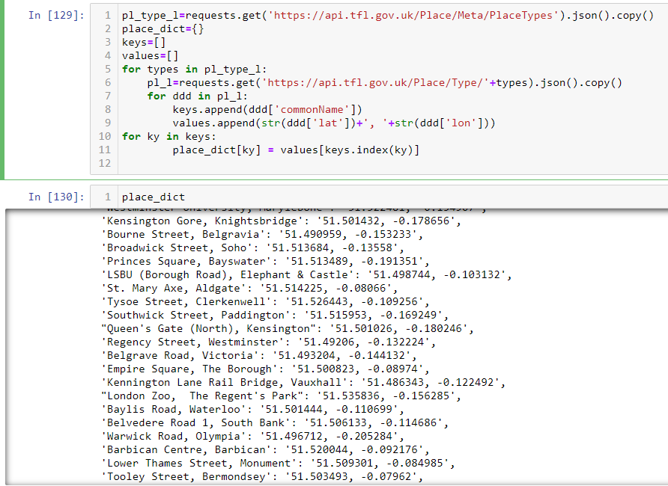
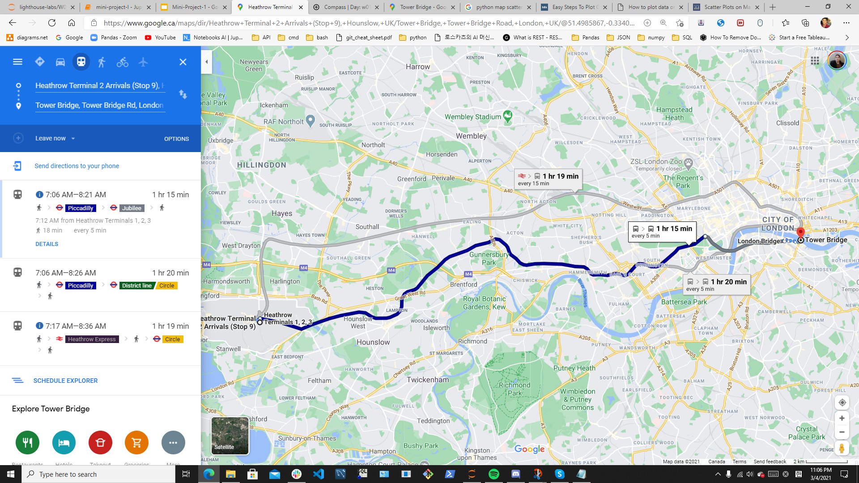
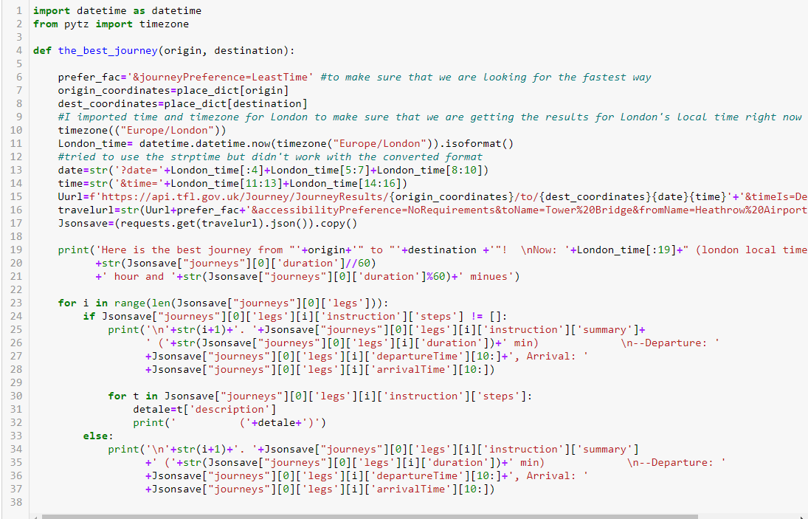
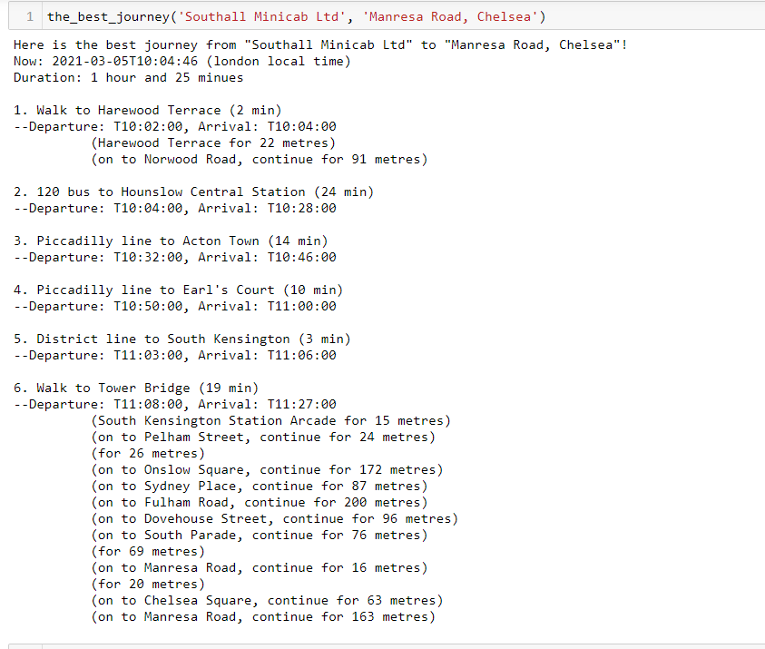
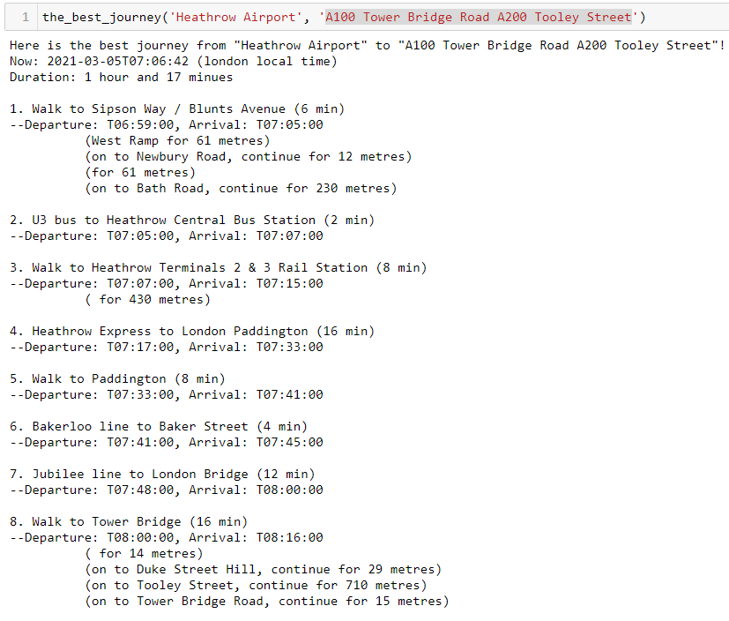
And a Bit More Later:
After a Bit of Coding:

